Slide 1

ExaO: Software Defined Data Distribution for Exascale Sciences
California Institute of Technology,
European Organization for Nuclear Research (CERN),
Yale University

Slide 2
The Compact Muon Solenoid Computing Model
Large raw datasets from LHC at the Tier-0 site
RAW Data: tens of PB per year
RECO and AOD: multiple times of RAW data depending on analysis requirements
RECO and AOD datasets are distributed to Tier-1 sites
RECO, AOD and simulation datasets are transferred among Tier-1~3 sites for analysis.
For more information, please contact us: supersdnprogramming@gmail.com

Slide 3
PhEDEx: CMS Data Transfer Service
Automatic Data Management and Movement in CMS
Number of files > 63,000,000
Average file size > 2.6GB
Total volume
> 160PB
Dataset hundreds to thousands files
Dataset transfer requests
400-500 per day
Multiple transfer patterns:
one-to-one,
one-to-many
many-to-many
Users submit requests through web interface
Central data movement decision based on history statistics
For more information, please contact us: supersdnprogramming@gmail.com

Slide 4
PhEDEx Architecture
Built on top of traditional multi-domain networks
Inflexible, static dataset level scheduling
Performance
• Inflexible infrastructures,
• Lack of real-time, global network view
• Infeasible of end-to-end data flow orchestration
• Traditional client/server mode to select source for all files at once
• Complete ignorance of destination sites’ potential as file providers
• No network resource allocation scheme
• Low concurrency
• Low link utilization
• Long transfer delay
For more information, please contact us: supersdnprogramming@gmail.com

Slide 5
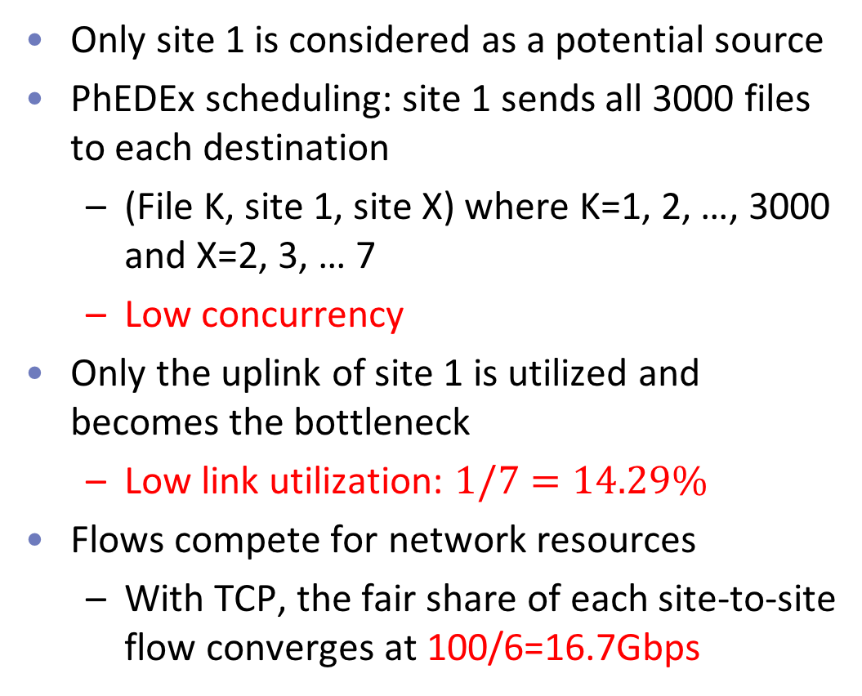
Example: Distributing Dataset X to All the Sites in PhEDEx
Dataset X (3000 50GB files)
Only site 1 is considered as a potential source
PhEDEx scheduling: site 1 sends all 3000 files to each destination
(File K, site 1, site X) where K=1, 2, …, 3000 and X=2, 3, … 7
Low concurrency
Only the uplink of site 1 is utilized and becomes the bottleneck
Low link utilization: $1/7=14.29\%$
Flows compete for network resources
With TCP, the fair share of each site-to-site flow converges at 100/6=16.7Gbps
Bottleneck
CMS Needs A More Efficient, Flexible Data Transfer Service

Slide 6
Design Challenges for An Flexible, Efficient Data Transfer Service
Challenge 1
Challenge 2
Challenge 3
Provision of a global, real-time, inter-domain network view
Flexible, dynamic schedule with high transfer concurrency
Efficient orchestration among end-to-end data flows with high network resource utilization
Solution?
ExaO: A Software Defined Data Transfer Orchestrator
For more information, please contact us: supersdnprogramming@gmail.com

Slide 7
ExaO: Software Defined Data Transfer Orchestrator
PhEDEx
ExaO
No real-time, global network view
Application-Layer Traffic Optimization (ALTO)
Collect complete network state at different domains (OpenDaylight)
Compute real-time routing information at different domains (ALTO-SPCE)
Compute global, on-demand, minimal, equivalent abstract routing state (ALTO-RSA)
Dataset level scheduling
Destination sites cannot become candidate sources until receiving the whole dataset
Low concurrency
Scheduler
Centralized, dynamic, network-aware file level scheduling
Leverage destination sites as candidate sources after file reception
High concurrency
No network resource allocation scheme
Data flows compete for network resources
Low utilization
Scheduler and Transfer Execution Nodes (TEN)
Global, dynamic rate allocation among data flows (Scheduler)
End host rate limiting to enforce allocation (TEN)
For more information, please contact us: supersdnprogramming@gmail.com
Notes:
Minimally invasive change on end host groups
Real-time, dynamic resource allocation under the existence of other network traffic
Not CMS or HEP specific, hence support any data intensive sciences.
Dataset distribution to N destination:
Maximal link utilization in the testbed
N times faster than dataset level scheduling

Slide 8
Components of ExaO
RESTful-API
Allow users submit and manage transfer request through different interface
ALTO
Collect on-demand, real-time, minimal abstract routing information
ExaO Scheduler
Centralized, efficient file-level scheduling and network resource allocation
FDT
Efficient data transfer tools on end hosts
Monalisa
Distributed monitoring infrastructure for real time monitoring of each transfer
Transfer Execution Nodes
Enforce scheduling and rate allocation decisions at end hosts
Enforce resource allocation in the network
For more information, please contact us: supersdnprogramming@gmail.com

Slide 9
ExaO Workflow
Users submit, track and manage dataset transfer requests
User Requests
For more information, please contact us: supersdnprogramming@gmail.com

Slide 10
ExaO Workflow
Users submit, track and manage dataset transfer requests
Scheduler queries NEW requests via ExaO RESTful interface
Scheduler queries ALTO controllers for routing state
User Requests
Routing Query
Routing Query
Routing Query
For more information, please contact us: supersdnprogramming@gmail.com

Slide 11
ExaO Workflow
Users submit, track and manage dataset transfer requests
Scheduler queries NEW requests via ExaO RESTful interface
Scheduler queries ALTO controllers for routing state
ALTO controller collects complete network state and computes on-demand, minimal, abstract routing state in response to query
Routing ACK
Routing ACK
Routing ACK
For more information, please contact us: supersdnprogramming@gmail.com

Slide 12
ExaO Workflow
Users submit, track and manage dataset transfer requests
Scheduler queries NEW requests via ExaO RESTful interface
Scheduler queries ALTO controllers for routing state
ALTO controller collects complete network state and computes on-demand, minimal, abstract routing state in response to query
Scheduler makes centralized, dynamic, file-level scheduling and global network resource allocation decisions
Schedule Decisions
Schedule Decisions
Schedule Decisions
Schedule Decisions
For more information, please contact us: supersdnprogramming@gmail.com

Slide 13
ExaO Workflow
Users submit, track and manage dataset transfer requests
Scheduler queries NEW requests via ExaO RESTful interface
Scheduler queries ALTO controllers for routing state
ALTO controller collects complete network state and computes on-demand, minimal, abstract routing state in response to query
Scheduler makes centralized, dynamic, file-level scheduling and global network resource allocation decisions
Transfer Execution Nodes (TEN) query updated scheduling and allocation decisions
TEN instruct efficient data transfer tools on end hosts (e.g., FDT) to enforce scheduling and allocation decisions
TEN Query
TEN instruction
TEN instruction
TEN ininstruction
TEN instruction
For more information, please contact us: supersdnprogramming@gmail.com

Slide 14
ExaO Workflow
Users submit, track and manage dataset transfer requests
Scheduler queries NEW requests via ExaO RESTful interface
Scheduler queries ALTO controllers for routing state
ALTO controller collects complete network state and computes on-demand, minimal, abstract routing state in response to query
Scheduler makes centralized, dynamic, file-level scheduling and global network resource allocation decisions
Transfer Execution Nodes (TEN) query updated scheduling and allocation decisions
TEN instruct efficient data transfer tools on end hosts (e.g., FDT) to enforce scheduling and allocation decisions
MonALISA sensors monitor data transfer status and send update back
Transfer Status
Transfer Status
Transfer Status
For more information, please contact us: supersdnprogramming@gmail.com

Slide 15
Practical Concerns
Minimally invasive changes on end host groups
Real-time, dynamic resource allocation under the existence of other network traffic
Not CMS or HEP specific, hence support any data intensive sciences
Dataset distribution to N destination
• Maximal link utilization in the testbed
• N times faster than dataset level scheduling
For more information, please contact us: supersdnprogramming@gmail.com

Slide 16
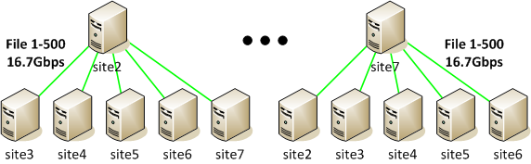
Example: Distributing Dataset X to All the Sites in ExaO
Dataset X (3000 50GB files)
Site 1 is the only source at the beginning
Each site can become a file provider once receiving files
Site 1 sends 3000/6=500 unique files to each destination site
Limit the rate of each (site 1, site X) flow as 100/6=16.7Gbps
Uplink utilization: 100%
Site X (X=2, 3, …, 7):
becomes a source to other destination sites after receiving a unique file from site 1
sends the received file to all other 5 destination sites, each at (100-16.7)/5=16.7Gbps
Uplink utilization: is 83.3%
Total link utilization: 6/7=85.71%
6 times of PhEDEx
Achieves theoretical maximum
For more information, please contact us: supersdnprogramming@gmail.com

Slide 17
SC 16 Demo: Datasets Distribution Among Different Host Groups
DatasetX:
Host1 -> Host2,3
Initial
Host 1,4 as sources
DatasetY:
Host4 -> Host5,6,7,8
Final
Host 2,3,5,6,7,8 as sources
For more information, please contact us: supersdnprogramming@gmail.com

Slide 18
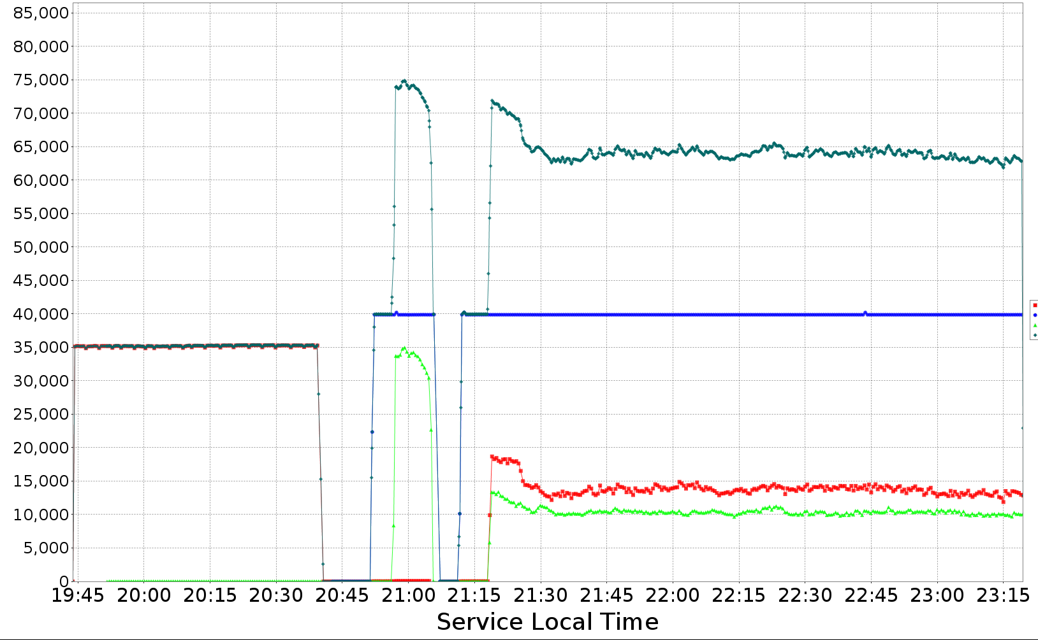
Results
Request submitted
Total rate
Host 1
Host 2, 3

Slide 19
SC 16 Demo: Datasets Distribution Among Different Host Groups
Host 1
Dataset X
Host 2, 3
Host 4
Dataset Y
Host 5, 6, 7, 8
Online soon
Twin 2U-SM
Host 1
Dell R930
Host 8
Twin 2U-SM
Dell Z9100 Switch
Dell Z9100 Switch
Host 7
Host 2
Dell R930
Twin 2U-SM
Dell R930
Dell R930
Dell R930
Host 3
Host 4
Host 5
Host 6
40Gbps full duplex link
100Gbps full duplex link
For more information, please contact us: supersdnprogramming@gmail.com

Slide 20
What Else?
“Super SDN Programming for Supercomputing”
Introduce a series of tools to simplify SDN control plane programming in data intensive science networks
Presentations at 5:30pm Wednesday and 11:30am Thursday
Demo: Implementing A Science DMZ Traffic Control Application
Run on a 6-switch network
Lasts all 3 days
For more information, please contact us: supersdnprogramming@gmail.com

Slide 21
Thank You! For more information, please contact us. supersdnprogramming@gmail.com

